Slide 1

UPI Transactions & Fraud Analysis
Presented By: Gulnaaz Ali, Data Analyst

Slide 2
The UPI Challenge: Growth vs. Risk
India's Unified Payments Interface (UPI) is experiencing explosive growth, revolutionizing digital transactions. However, this rapid adoption brings significant challenges, primarily the escalating risk of fraud.
Unusual Patterns & High-Value Risks
Vulnerable Networks & Devices
Lack of Clear Insights
Banks and businesses often lack granular data on peak usage, demographic preferences, or individual bank performance, hindering effective strategy.
Fraudsters exploit unusual transaction patterns and target high-value payments, posing a threat to users and financial institutions.
Specific network types, devices, and merchant categories are proving to be fertile ground for fraudulent activities.
This gap in understanding impedes service improvement, fraud reduction, and the crucial task of building user trust.

Slide 3
Key Objectives: Driving Secure & Insightful UPI Growth
Our analysis aims to address these challenges with a multi-faceted approach:
01
02
Transaction Trend Analysis
Fraud Pattern Detection
Track UPI trends across banks, devices, and merchant categories to identify operational patterns.
Detect and monitor evolving fraud patterns, with a focus on high-value transactions and emerging threats.
03
04
Customer Behavior Insights
Actionable Intelligence
Understand user behavior by age groups, states, and peak usage times to optimize service delivery.
Provide clear, actionable insights for enhancing security, optimizing services, and building enduring user trust.

Slide 4
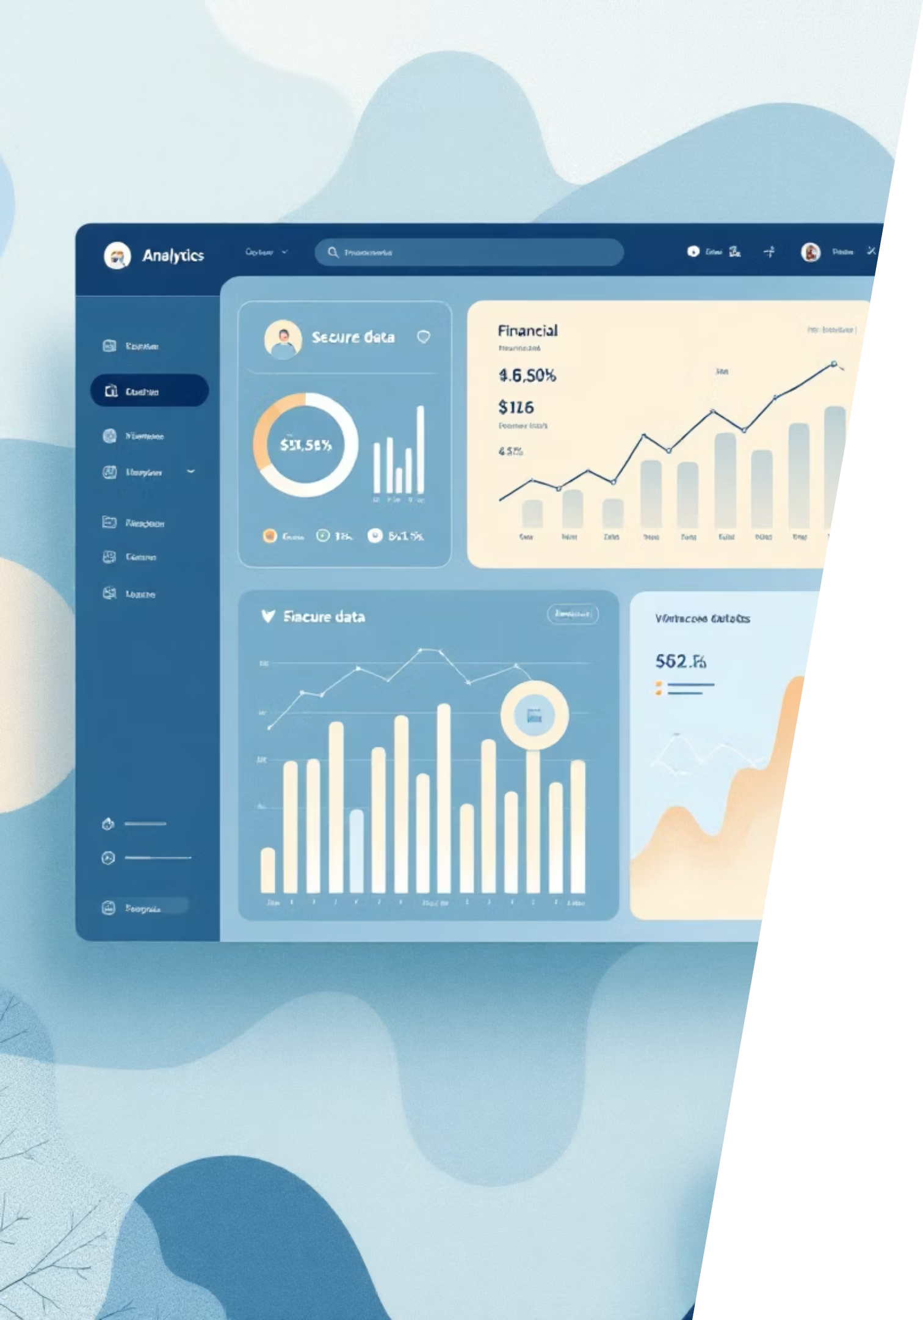
Data Foundation: A Comprehensive View
Our analysis leverages a rich dataset combining transaction details, user demographics, and critical fraud indicators. This holistic approach ensures a 360-degree understanding of UPI usage and risks.
Transactional Data
Demographic & Fraud Data
Transaction ID
Amount
Transaction ID
Date-Time & Weekend Flag
Sender & Receiver Age Group
Transaction Status
Bank Name
Network Type
Device Type
Fraud Flag

Slide 5
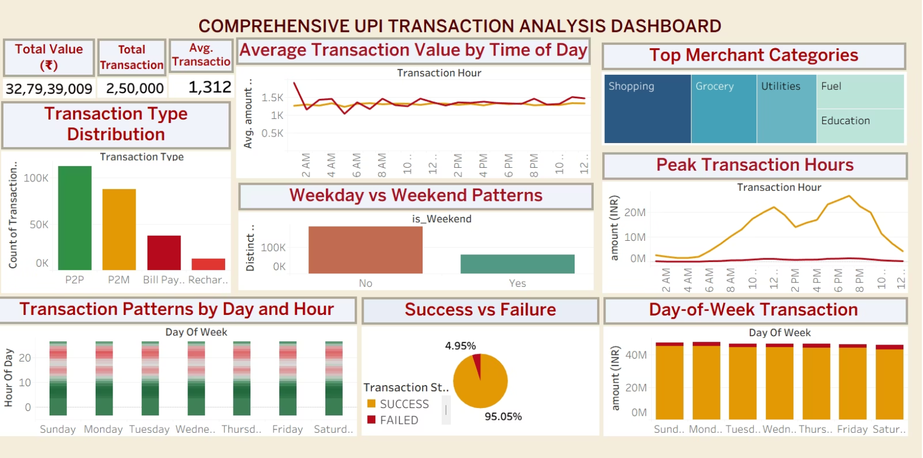
Understanding UPI Usage: Key Transaction Trends
Our analysis of over 2.5 lakh transactions, totaling ₹32.79 crore, reveals distinct patterns in UPI adoption and usage.
Transaction Volume: P2P dominates, followed by P2M, highlighting the primary use cases.
Peak Hours: Evenings (6-9 PM) are rush hours, with a day-hour heatmap showing clear activity spikes.
Weekend Dynamics: Weekdays have higher transaction volume, but weekends show greater value per transaction.
Spending Categories: Shopping and Grocery are the leading spending categories.
Success Rate: A robust 95% success rate, with only 5% transaction failures.

Slide 6
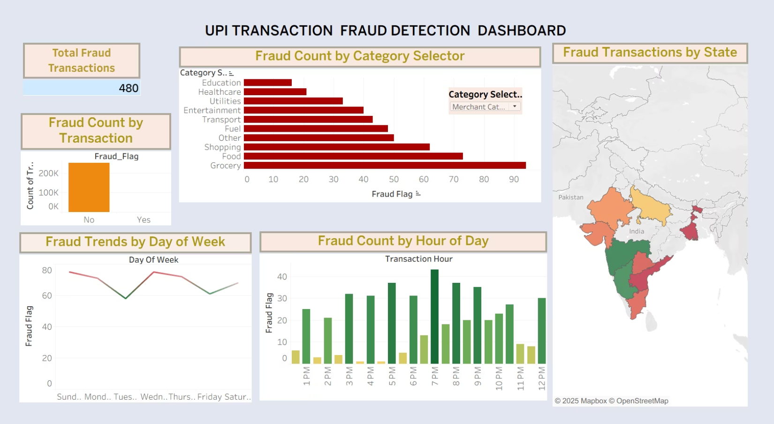
Unmasking Fraud: Patterns & Vulnerabilities
480 suspicious transactions were identified, revealing critical fraud hotspots and risk factors across various dimensions.
Targeted Categories: Grocery, Food, and Shopping are most vulnerable.
Device Risk: Android users experience the highest number of fraud cases.
Network Vulnerability: 4G and 5G networks show higher fraud than WiFi/3G.
High-Risk States: Specific states are identified as prominent fraud hotbeds.
Peak Fraud Hours: Evening hours (6-10 PM) align with peak fraud activity.
Mid-Week Spikes: Wednesday-Thursday record more fraud than weekends.
Bank Exposure: Certain banks, notably SBI, report higher incidents.
Age Group Impact: Young adults (18-30) are disproportionately affected.

Slide 7
Consolidated Insights: A Snapshot of UPI Dynamics
Our analysis provides a comprehensive overview of UPI transaction behavior, emerging fraud patterns, and key demographic and geographic hotspots.
1
2
3
Transaction & Activity
Fraud Landscape
Demographic & Geographic
2.5 lakh transactions (₹32.79 Cr), dominated by P2P; peak usage in evenings (6-9 PM); 95% success rate. Shopping & Grocery are top categories.
480 suspicious cases primarily in evenings (6-10 PM) and mid-week. Android users and 4G/5G networks face higher risk.
Young adults (18-30) are most affected; metro cities see high volume, but Tier-2 states show higher fraud ratios. Specific banks have elevated exposure.

Slide 8
Actionable Recommendations: Building a Safer UPI Ecosystem
Based on our insights, we propose targeted strategies to mitigate fraud, enhance user experience, and optimize UPI services.
1
High-Value Payment Security
Implement biometric verification or secondary OTP for high-value transactions.
2
Network & Device Hardening
Collaborate with telecom providers to monitor 4G/5G fraud; introduce device fingerprinting for Android.
3
Targeted User Awareness
Launch campaigns for 18-30 age group on safe UPI practices. Provide in-app alerts and one-click reporting.
4
Bank-Specific Security Upgrades
Banks with high exposure (e.g., SBI) must upgrade fraud detection and internal security policies.
5
Merchant Category Monitoring
Enforce stronger compliance and monitoring for high-risk categories like Grocery, Food, and Shopping.
6
Optimize Peak Hour Performance
Improve success rates during evening rush hours by optimizing server loads and backend systems.
7
Incentivize Off-Peak Usage
Launch cashback/reward programs to encourage transactions during low-traffic periods.
8
Personalized Services
Leverage demographic and geographic insights to personalize services and build customer trust.

Slide 9








Business Impact: Driving Value Through Insight
Implementing these recommendations will yield substantial benefits across security, operations, and strategic growth.
Enhanced Security
Increased Trust & Retention
Reduced financial losses from fraud and increased user confidence in the UPI ecosystem.
Higher adoption rates and sustained growth in UPI usage as users feel more secure.
Higher Operational Efficiency
Stronger Regulatory Compliance
Minimized transaction failures and reduced customer support costs.
Reduced risk of penalties and reputational damage for banks and fintechs.
Personalized User Experience
Revenue Growth
Higher engagement and repeat transactions driven by tailored services.
Increased transaction volumes and cross-selling opportunities.
Competitive Advantage
Improved Decision-Making
Positioning as the most secure and reliable UPI provider in the market.
Actionable insights for better product development and service strategies.

Slide 10

Thank YouQuestions?

